Slide 1
MIDTERM REVIEW
APS106

Slide 2
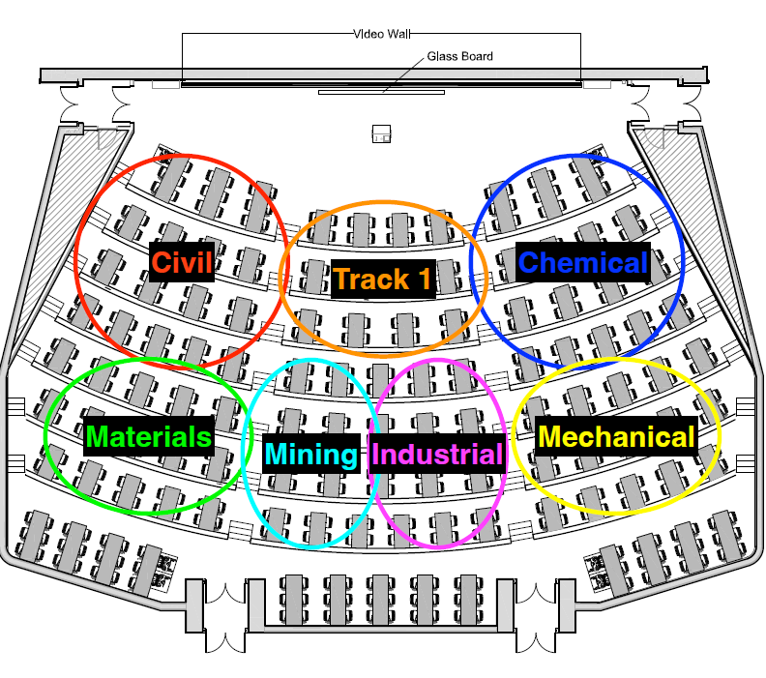

Slide 3
Rules of the GAME
Must use button on the table to answer question verbally and explain your answer – you will be called on to answer by one of the instructors
Must tell us which discipline you’re in before you answer for points (we’ll rely on the honour system)
If you get the answer right, you pick the next category
If you get the answer wrong, the next person whose hand is up can steal
Everyone is here to learn and review for the midterm so be kind to everyone who answers!

Slide 4
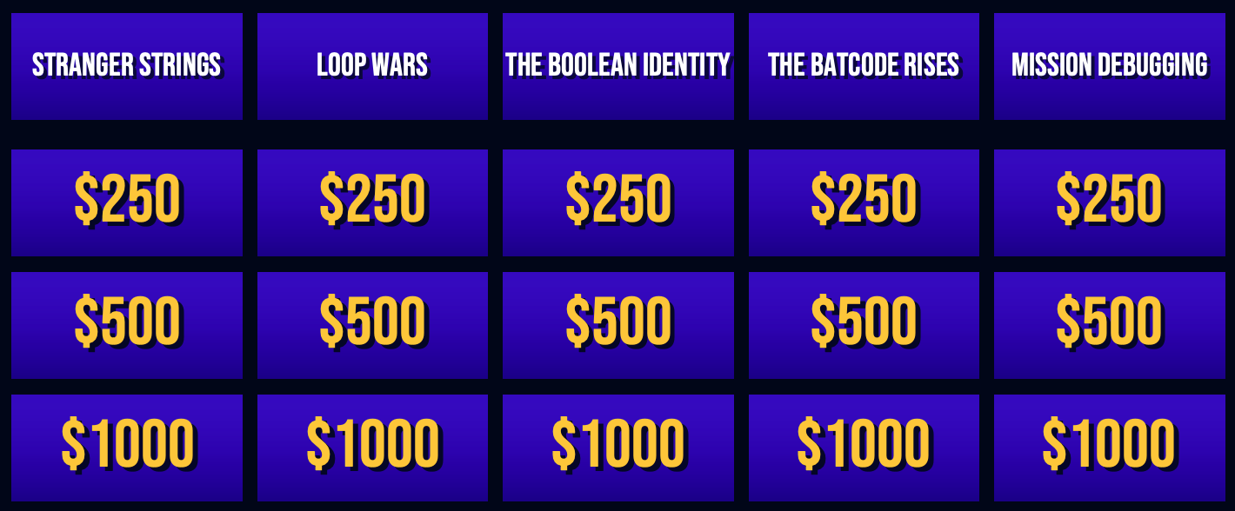
Panel

Slide 5
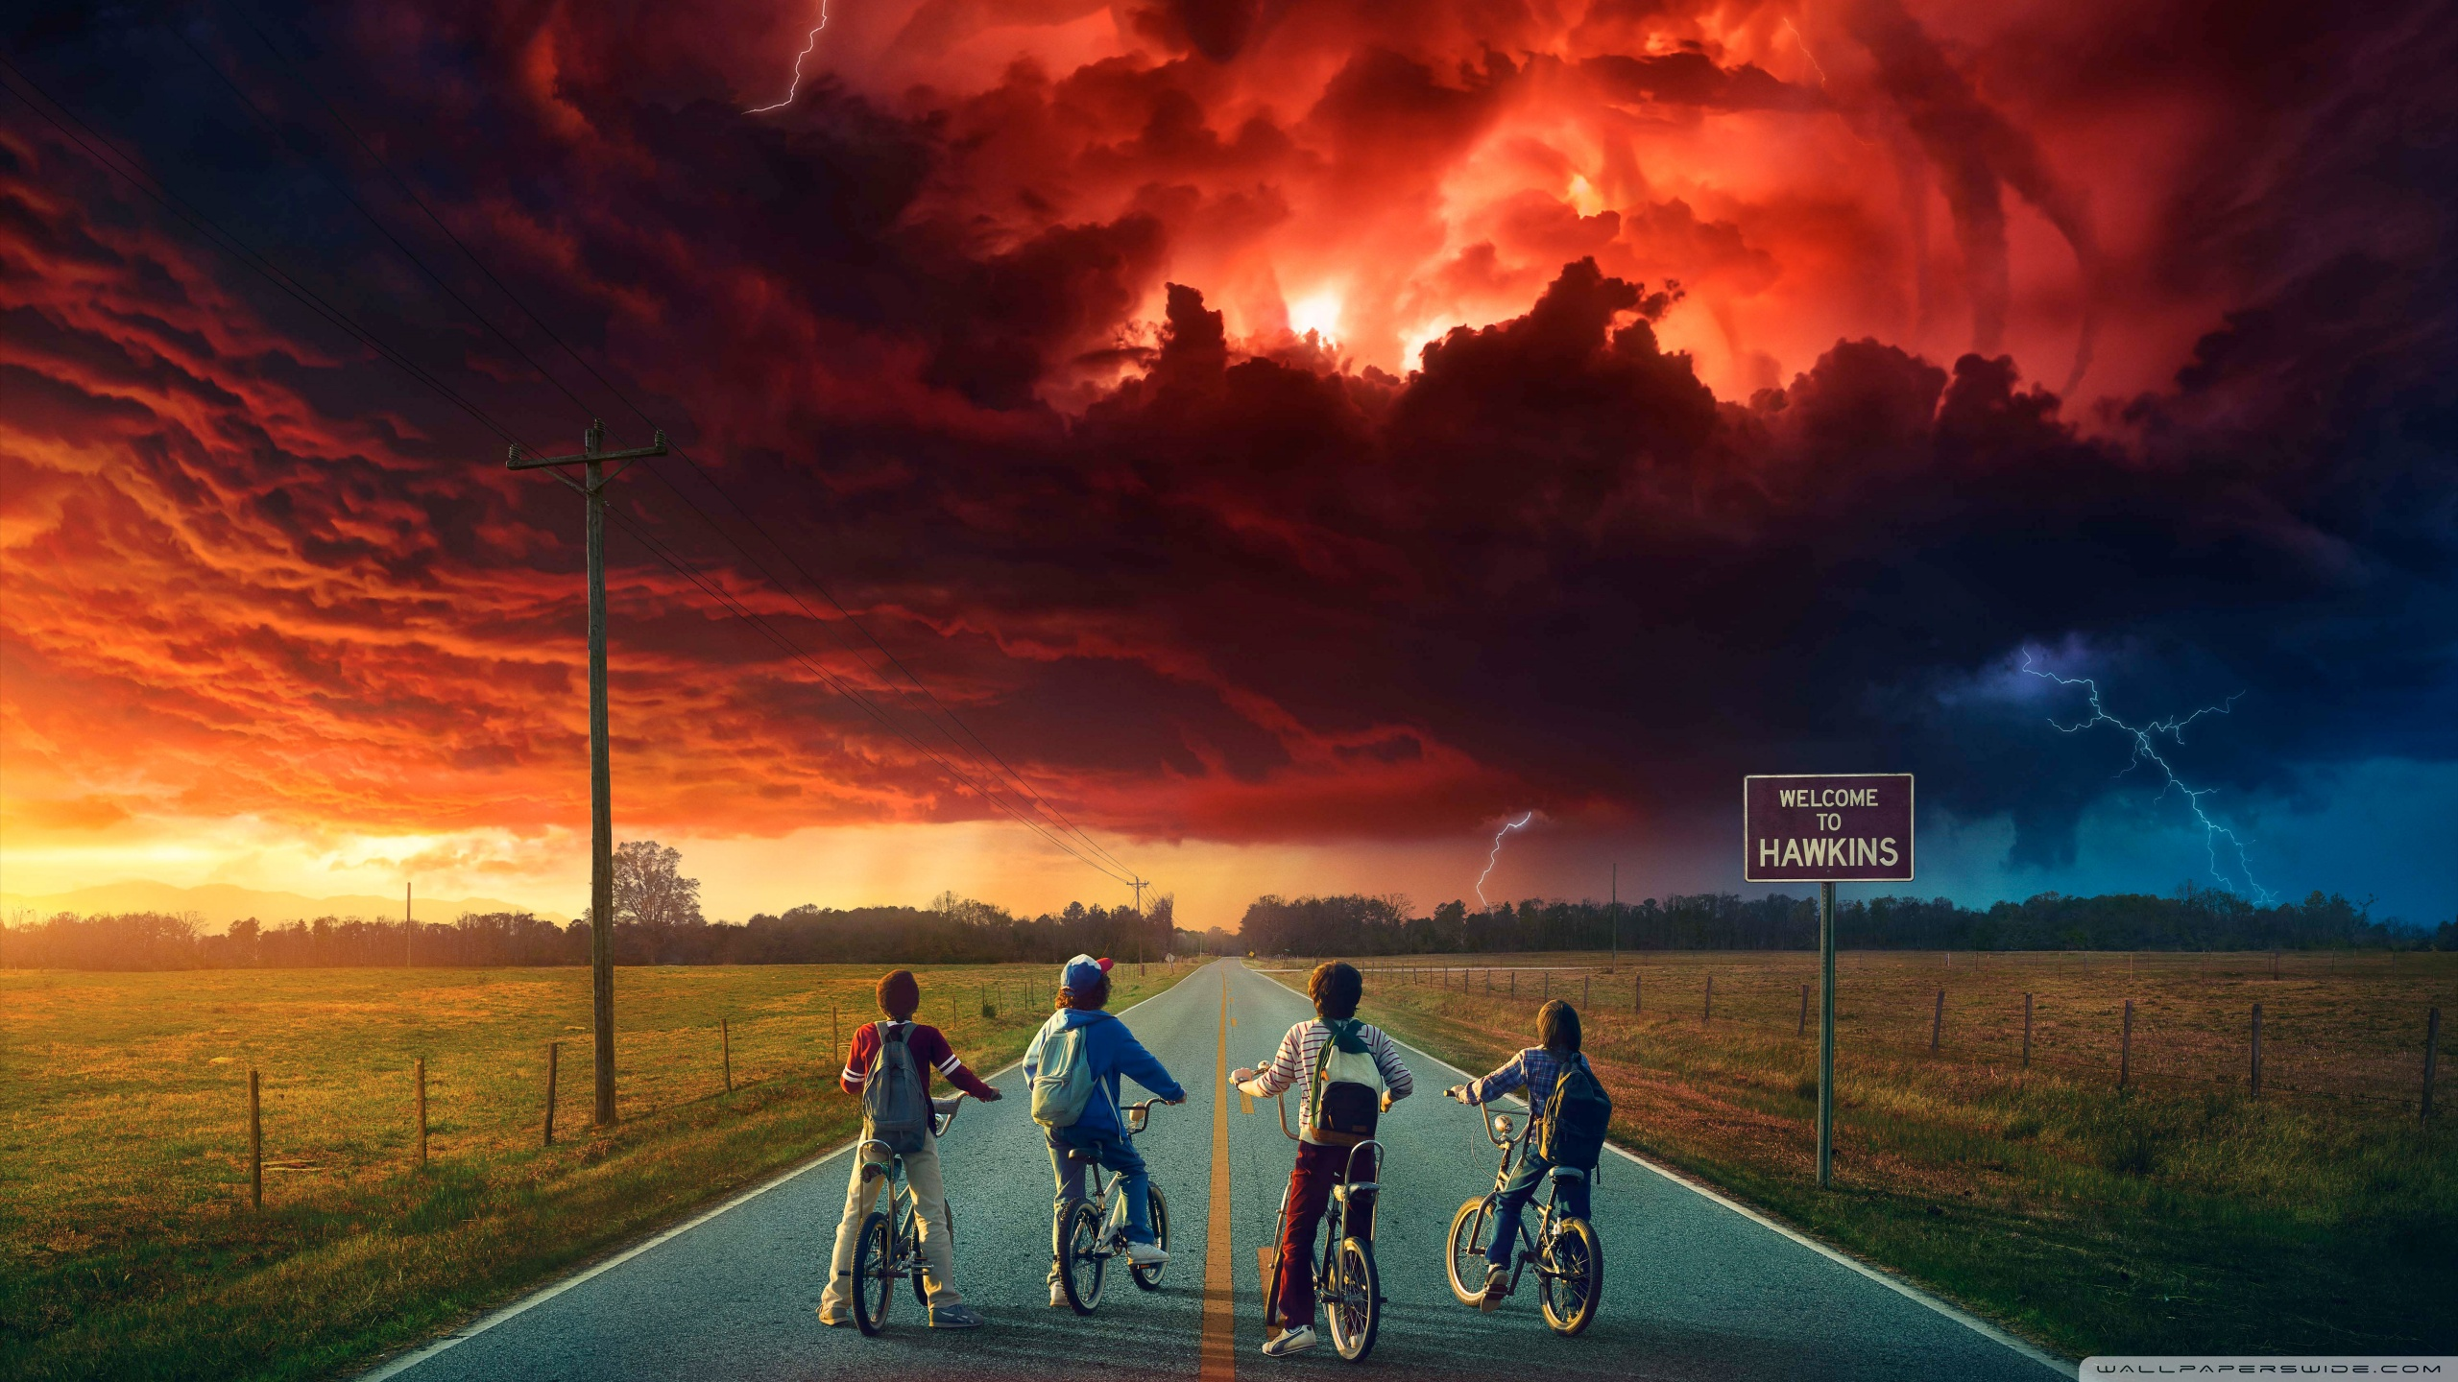
STRANGER STRINGS
"Because Python strings can hide secrets — just like Joyce’s Christmas lights!"

Slide 6
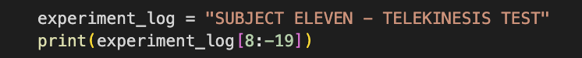
Hawkins Lab Experiment · $250
What is the output?
Question board

Slide 7
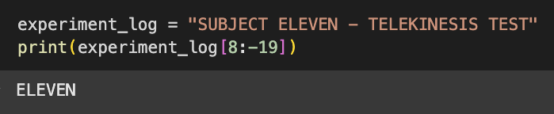
things and strings · $250
What is the output?
Question board

Slide 8
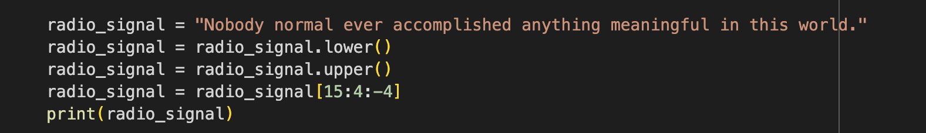
Dustin’s Secret Transmission · $500
What is the output?
Question board

Slide 9
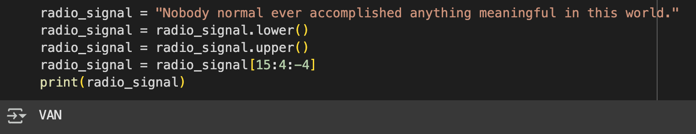
Dustin’s Secret Transmission · $500
What is the output?
Question board

Slide 10
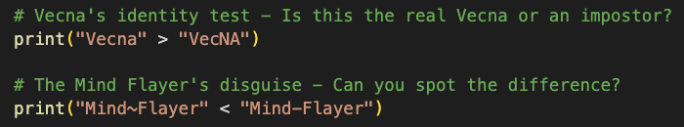
not everyone is who they seem· $1000
What is the output?
Question board

Slide 11
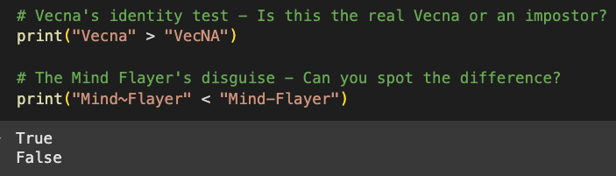
not everyone is who they seem· $1000
What is the output?
Question board

Slide 12

Loop Wars
May the Loops & Logic Be With You

Slide 13
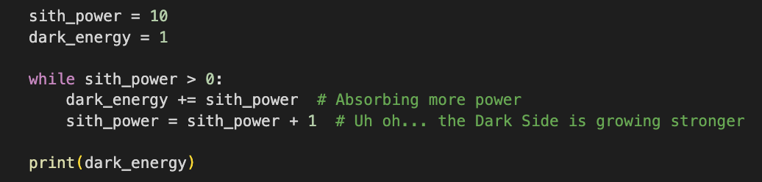
Loops of the Sith · $250
Verbally explain what happens in the following piece of code:
Question board

Slide 14
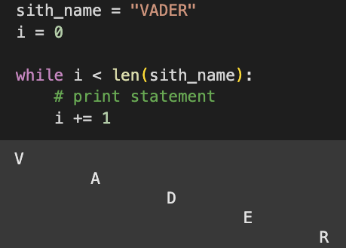
Descent into Darkness · $500
Provide the print statement that will give this output?
Question board

Slide 15
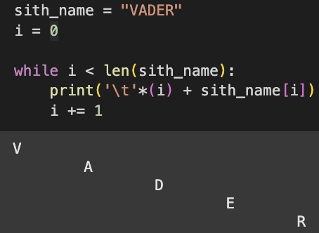
Descent into Darkness · $500
Provide the print statement that will give this output?
Question board

Slide 16
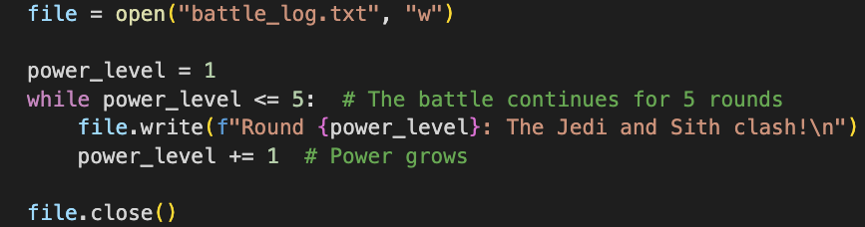
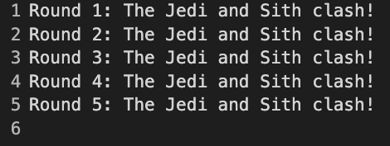
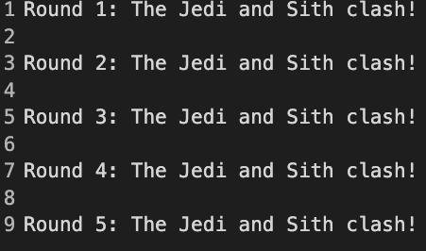
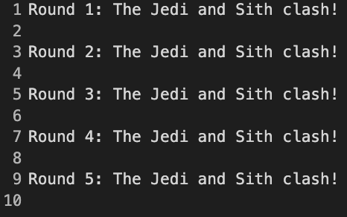
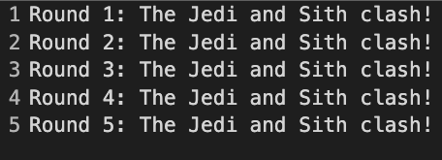
Battle of Loops: The Files of Fate · $250
What will the contents of the files look like?
A
B
D
C

Slide 17
Battle of Loops: The Files of Fate · $250
What will the contents of the files look like?
B

Slide 18
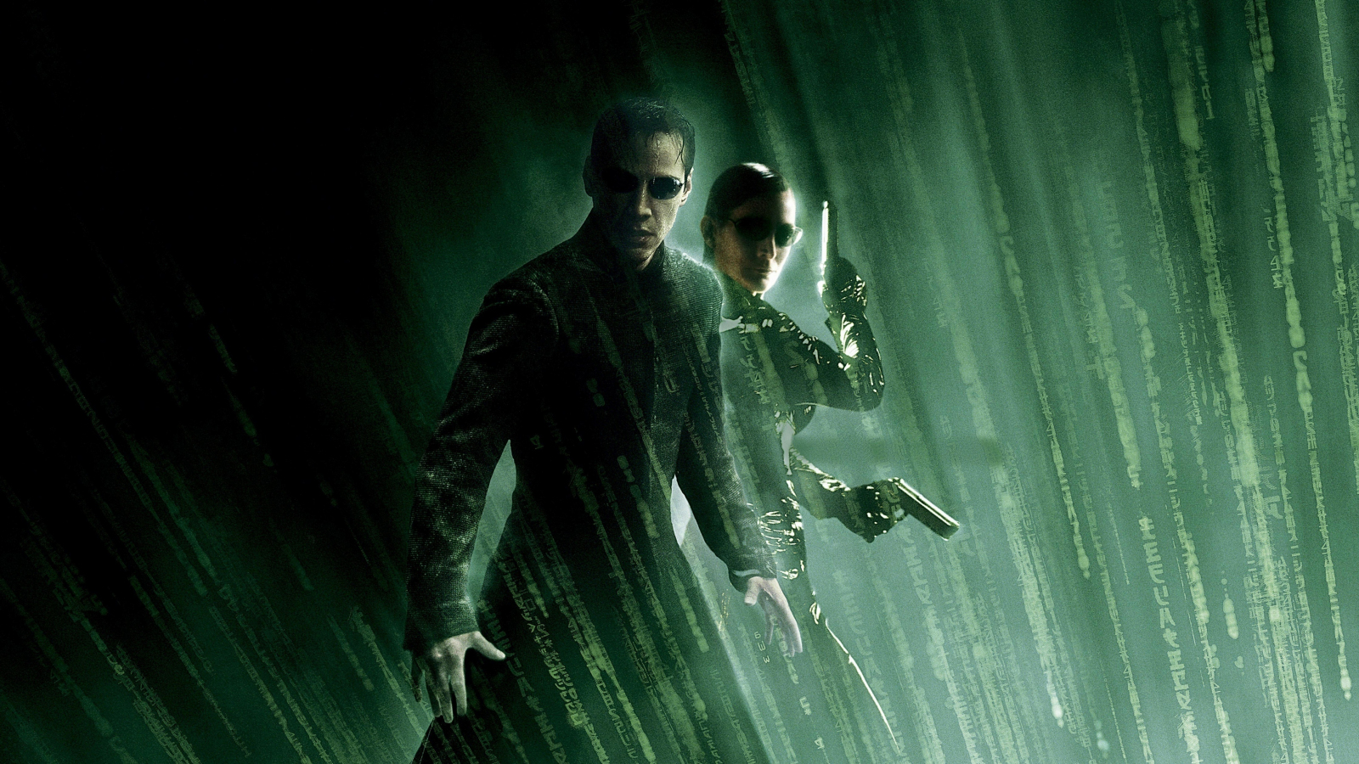
The Boolean Identity
The difference between knowing the truth… and living a lie.

Slide 19
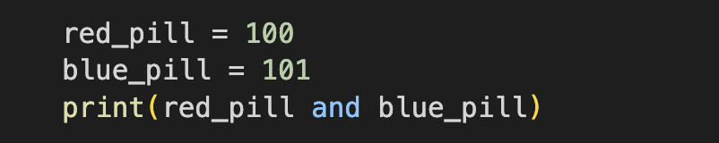
The Pill Dillema · $250
What is the Output?
Question board

Slide 20
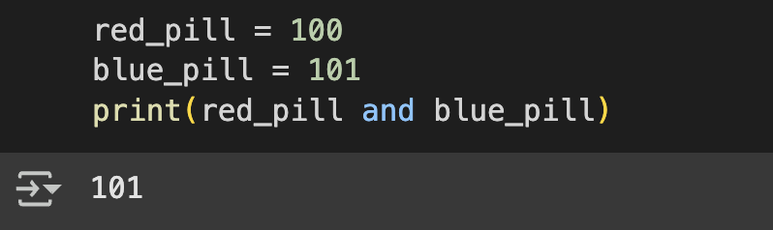
The Pill Dillema · $250
What is the Output?
Question board

Slide 21
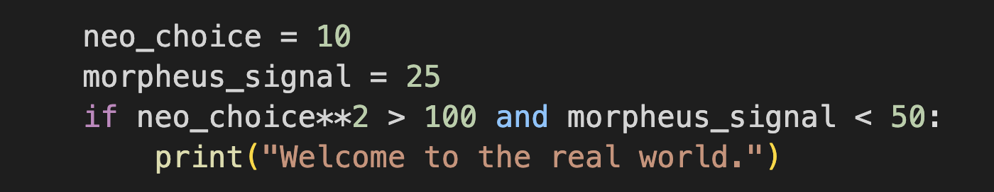
Agent Smith’s Logic Trap· $500
What is the Output?
Question board

Slide 22
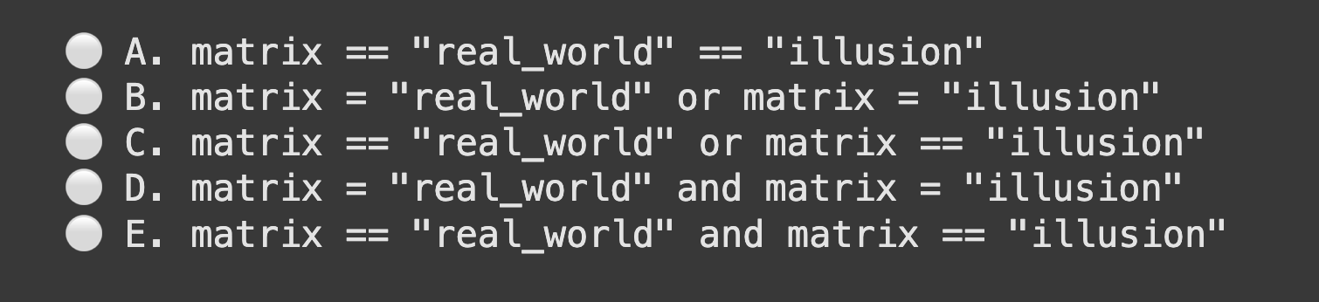
The One Condition · $1000
Which Boolean condition will evaluate True when matrix is equal to "real_world" or "illusion"?
Question board

Slide 23
The One Condition · $1000
Which Boolean condition will evaluate True when matrix is equal to "real_world" or "illusion"?
Question board

Slide 24

Every function needs structure—just like Gotham needs order.
The
Batcode Rises

Slide 25
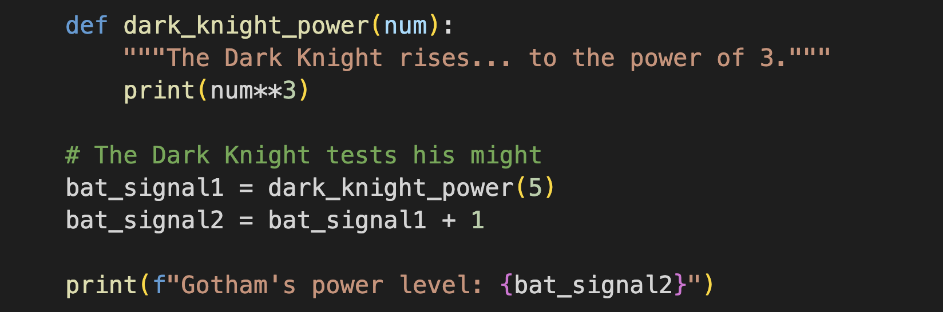
true power of the Dark Knight · $250
What is the outcome of executing this code?
Question board

Slide 26
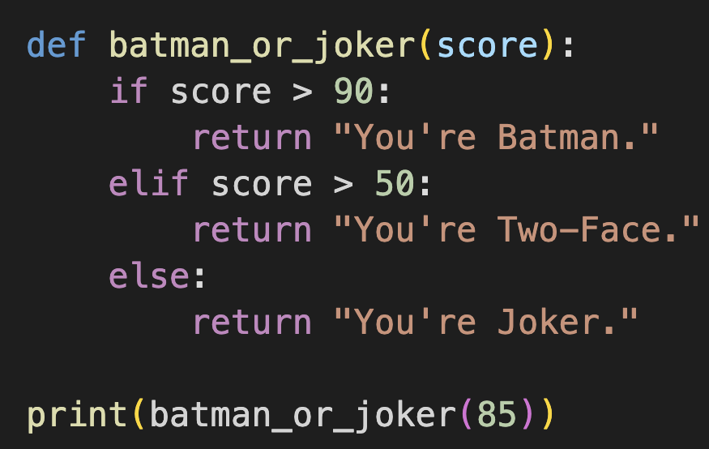
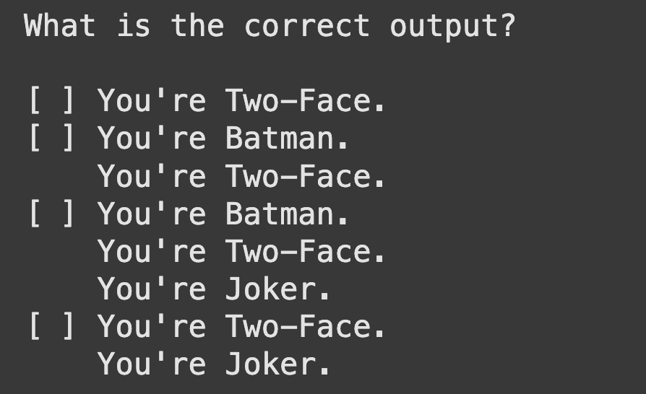
The Dark Knight’s Moral Code · $500
What is the Output?
A
B
C
D
Question board

Slide 27
The Dark Knight’s Moral Code · $500
What is the Output?
A
B
C
D
Question board

Slide 28
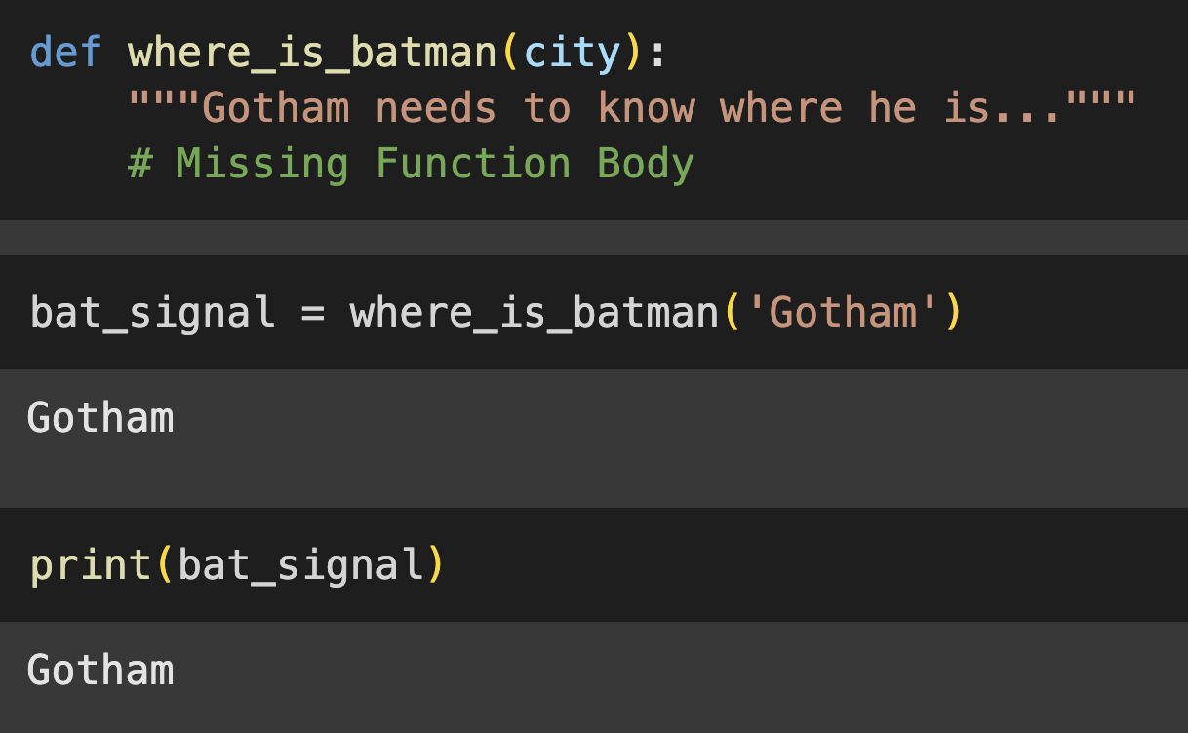
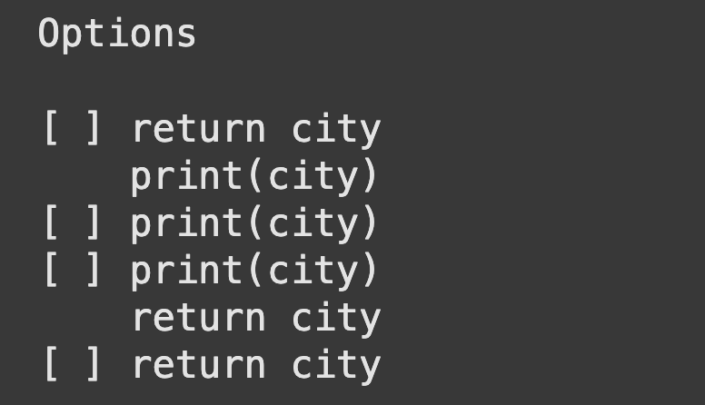
Where is he?!· $1000
Select the missing function body from the options below
A
B
C
D
Question board

Slide 29
Where is he?! · $1000
Select the missing function body from the options below
A
B
C
D
Question board

Slide 30

Mission:
DebugGING
Because every bug is a ticking time bomb… can you defuse it in time? ⏳💥

Slide 31
Operation Divide & Fall · $250
Mission Briefing:
A critical operation was executing when a secret code was asked to divide by zero. The system crashes. Identify the type of error before the mission fails.
Question board

Slide 32
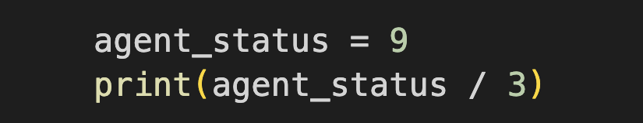
Undercover Syntax · $500
Will this code execute, or has it been sabotaged?
Question board

Slide 33
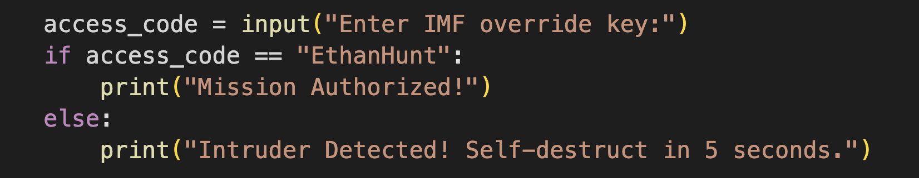
The Disavowed Input· $1000
What kind of error is that?
A hacker inputs “ethanhunt” and receives the response “Intruder Detected! Self-destruct in 5 seconds.”
Question board

Slide 34

Final
Jeopardy

Slide 35
Mastering the Ocean’s Flow
On Pandora, water changes depending on the environment.
At freezing temperatures, it becomes solid ice.
When the temperature is normal, it flows gently.
When it’s too hot, it turns into steam.
Your task:
Determine the state of Pandora’s water based on its temperature.
Write a function that determines whether Pandora’s water is ice, liquid, or steam based on temperature.
Question board

